Slide 1
Let’s talk about
ONLINE GAMING
...and how to keep our children safe,

Slide 2
LET’S START WITH A QUIZ TO UNDERSTAND THE RISKS.

Slide 3
TRUE
FALSE
‘My child is a girl and online gaming only affects boys, so I don’t need to be concerned about this...’

Slide 4
Answer:
FALSE
RECENT STUDIES HAVE FOUND THAT GAMERS TEND TO BE APPROXIMATELY 50-50 MALE VS. FEMALE (THERE ARE ALSO MANY NON-BINARY GAMERS) AND SOME STUDIES SUGGEST ROUGHLY 52% OF GAMERS ARE WOMEN AND GIRLS. THIS IS DUE IN PART TO MANY MORE PEOPLE STARTING TO PLAY ONLINE GAMES DURING THE PANDEMIC.

Slide 5
But...did you know?
Many female gamers report receiving rape threats from male gamers
Female gamers report very high levels of misogyny directed towards them
59% of women mask their gender, while 55% use either non-gendered or male gendered identities when playing online.
Research has found that the more successful the female gamer is, the more misogyny she will experience

Slide 6
MORE
LESS
2021 Research from UCL found that there is a link between boys who regularly play video games at age 11 and the development of depressive symptoms.
Do we think the research found that the boys were MORE likely or LESS likely to develop symptoms of depression?

Slide 7
Did you know?
What do you think they might be?
…the answer is LESS likely! The research found that those playing regularly at 11 were less likely to develop symptoms 3 years later.
- This suggests the solution is NOT to avoid going online but to develop healthy habits.
There are lots of positive elements of online gaming for young people

Slide 8
TRUE
FALSE
Extremist groups are known to use online gaming to target and recruit young people, in order to radicalise them.

Slide 9
TRUE
RESEARCHERS FROM TECH AGAINST TERRORISM IDENTIFIED THE ONLINE GAME CREATION-SYSTEM ROBLOX AS HAVING BEEN USED BY RIGHT-WING EXTREMISTS TO RECREATE ‘PLAYABLE’ VERSIONS OF INFAMOUS FAR-RIGHT ATTACKS. FOR INSTANCE
-Users were invited to roleplay Anders Breivik’s 2011 attack on the Norwegian island of Utoya,
-the 2019 mosque shootings in Christchurch, New Zealand,
-Simulations of vehicle attacks on protesters (echoing what took place in the BLM protests in America)
-the 2019 terrorist attack in El Paso, Texas.
The UK white-nationalist group Patriotic Alternative has been found to actively target younger recruits and recently started Call of Duty Warcraft gaming tournaments for its supporters.
Patriotic Alternative has encouraged youngsters to host livestreamed “zoomer nights”, named after the “Gen Z” age-group born between the late 1990s and early 2010s.

Slide 10
TRUE
FALSE
Kim Kardashian had to have an awkward conversation with her son Saint (now aged approximately 8) after he was playing Roblox and managed to stumble across a game created out of his mum’s sex tape. This was a game openly available for children to access.

Slide 11
TRUE
THE NSPCC AND CHILDLINE TOLD THE BBC IN 2021 THAT SINCE THE PANDEMIC, THE NUMBER OF CHILDREN CALLING THEIR HELPLINE WITH CONCERNS ABOUT ROBLOX HAS INCREASED FIVE-FOLD.
I MET THIS USER ON ROBLOX WHEN I WAS, LIKE, 10. HE SAID HE WAS MY AGE (ALTHOUGH NOW I KNOW THAT WAS A LIE) AFTER A WHILE, HE ASKED ME TO SEND PICTURES AND IF I DID, HE WOULD GIVE ME ROBUX IN THE GAME - SO I SENT HIM SOME PICS. AFTER THAT, HE STARTED ASKING FOR MORE PICS AND EVEN THREATENED TO POST THE ONES HE HAD IF I SAID NO.
girl aged 14
I WAS PLAYING ROBLOX AND I WAS ON A GAME WHERE YOU WORK AT A PIZZA PLACE AND TWO PEOPLE WERE PRESSURING GIRLS TO DO INAPPROPRIATE STUFF WITH THEM AND IF THEY DID, THEY WOULD GET EXTRA MONEY IN THE GAME.
boy aged 12

Slide 12
LET’S CONSIDER GROOMING
"WE KNOW THAT WE CAN IDENTIFY SEVERAL LANGUAGE INDICATORS THAT WE HOPE WILL RAISE AWARENESS OF THE KIND OF THINGS THAT PARENTS, EDUCATORS, THOSE WORKING WITH CHILDREN MAY WANT TO LOOK FOR," SAID PROF LORENZO-DUS (SWANSEA UNIVERSITY)
"SEXUALLY EXPLICIT LANGUAGE IS ONE INDICATOR - BUT IT IS NOT THE ONLY INDICATOR.
"WHAT WE HAVE IS A VERY-MARKED INTEREST IN THE VICTIM, ASKING A LOT OF PERSONAL INFORMATION: WHERE THEY LIVE, DOES MUM AND DAD WORK, HOW LONG DO THEY GO ON THE INTERNET, IF IT IS MINECRAFT - HOW LONG DO THEY PLAY?
"IT IS ALL THIS BONDING TALK THAT SEEMS TO BE GEARED TOWARDS FRIENDSHIP THAT THEY USE AS A WAY TO HOOK THE VICTIM. IT IS A WAY TO DEVELOP TRUST."
THE RESEARCHERS FOUND THAT SOMETIMES THE GROOMING PROCESS CAN GO FROM AN INITIAL "HI - WHAT'S YOUR NAME" ONLINE APPROACH TO CYBER-SEXUAL ABUSE TAKING PLACE WITHIN MINUTES.
THEY ALSO FOUND THAT, DESPITE POPULAR BELIEFS, MOST GROOMERS DID NOT PRETEND TO BE CHILDREN AND WERE OPEN ABOUT BEING ADULTS WHEN THEY APPROACHED POTENTIAL VICTIMS.
THE AGE RANGE WAS ALSO WIDER THAN MANY THINK - FROM 60 DOWN TO ABUSERS AS YOUNG AS JUST 18-YEARS-OLD.”
https://www.bbc.co.uk/news/uk-wales-38284216

Slide 13
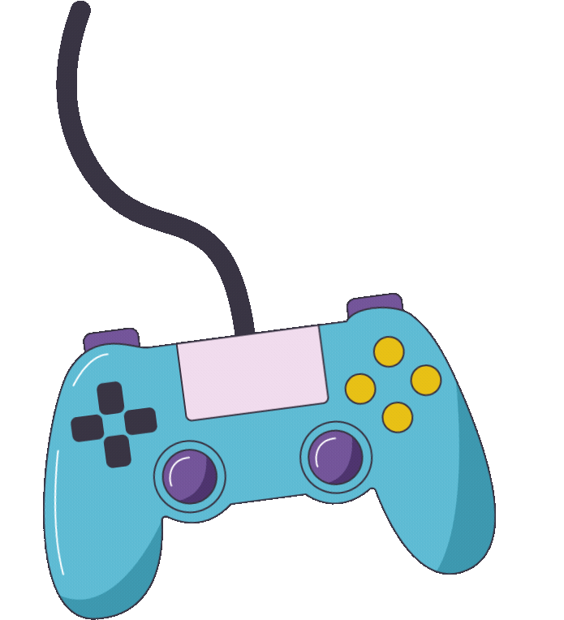
WHAT ABOUT MY CHILD WHO CAN’T GAME ON THEIR OWN?
We still need to be aware of the risks.

Slide 14
WHAT CAN THEY SEE? WHAT CAN THEY HEAR?

Slide 15
IMAGINE WATCHING SOMEONE ELSE WATCHING A HORROR FILM...
It can be very stressful to overhear bad language or shouting, or explosions
They might be able to hear inappropriate interactions and could find this scary or seek to emulate that behaviour
Watching gaming could mean they see violent, scary or sexual content

Slide 16
WWW.PEGI.INFO
Use this site to research before you:
buy a game
let your child download a game
play a game (or allow another of your children to) in front of your child

Slide 17
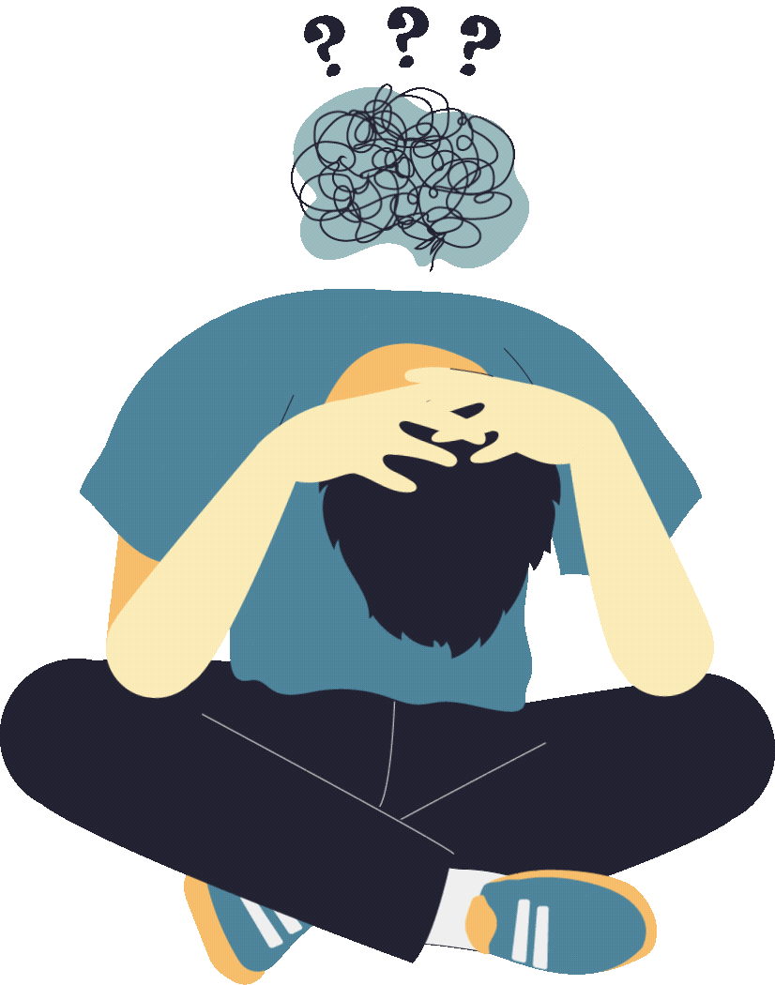
WHY?
Famous games that are popular with children and young people have had themes such as beheading people, murdering civilians, and raping and murdering sex workers...

Slide 18
Let’s watch a video.
LISTEN TO YOUR SELFIE - THE GAME

Slide 19
Have you heard of Breck Bednar?
Breck’s last game

Slide 20
What else do we need to be aware of?
Balancing gaming with other activities - and taking regular movement and eye breaks
Use parental controls and safety settings - when you buy your devices, you should be able to request that someone in the shop helps you to set these up.
Remember, some decompression time - our children might struggle to separate reality from the gaming world.

Slide 21
Info adapted from Internet Matters.org Gamesafe Guide.
‘Let’s Play’ videos
As well as playing themselves, children and young people also
watch other gamers on videos sharing sites online.
Check out the gamers and channels your child watches as the
content and commentary may contain offensive language, violent,
sexual or other adult/mature themes in the videos or the comments sections.

Slide 22
Watching live gaming
There are several platforms where young people can watch and interact live with gamers broadcasting their gaming, and even broadcast themselves.
As these are real-time there is a pretty good chance that they will contain offensive language and adult themes, plus there is the opportunity to chat with
those watching the streams

Slide 23
Using the Discord app
Discord’s Transparency Report in 2021 reveals that 32.8% of users were subject to harassment on the platform. 11% were victims of cybercrime followed by 8.1% of graphic content.

Slide 24
Gambling
Be aware of the way some games encourage the players to spend
money, sometimes effectively ’gambling’ to improve their experience.
Agree together how you will manage
in-game spending.

Slide 25
Consider a family contract before getting new devices
Think about having the device in a communal room where you can hear what’s going on
Think about whether you want them ro use headphones!
Play it first - see what you think!
Set rules such as your child only playing with friends they know from school (and whose parents/carers you know well)
Set time limits and encourage your child to understand when they’re getting too ‘sucked in’

Slide 26
National Online Safety app
Free to download for parents, you can search for almost every popular social media platform or game - and see what they say about how to keep your child safe on there.

Slide 27
Any questions?
REMEMBER, IF YOU’RE WORRIED - YOU CAN CONTACT THE PASTORAL TEAM ON 0121 569 7089

Slide 28
THANK YOU FOR COMING!

