Slide 1
Online Safety
Beth Davies Safeguarding Officer
Beth Davies, Safeguarding Officer.

Slide 2
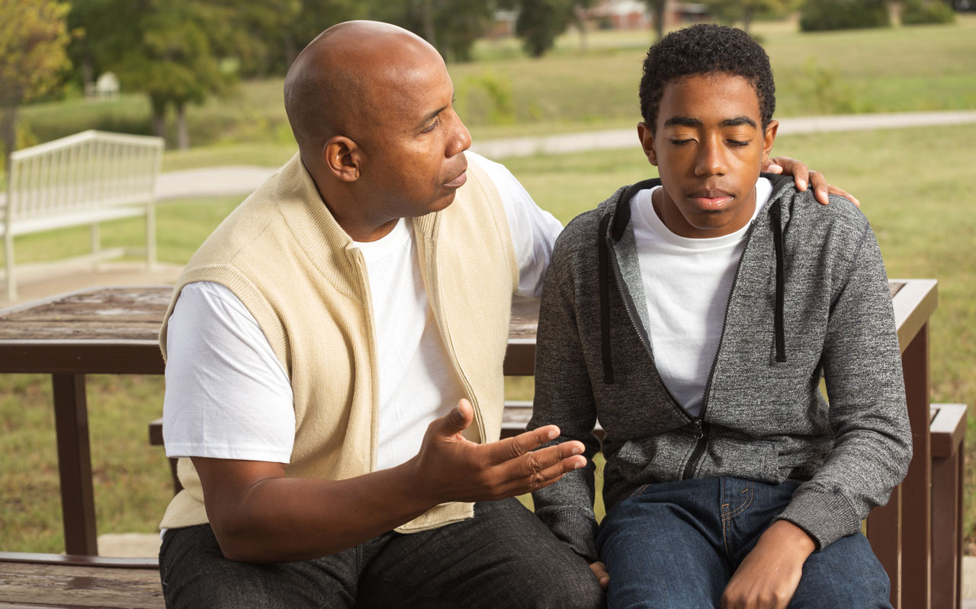
The Number One Message:
DON’T PANIC – TALK TO THEM.
Sometimes we can feel like we're always one step behind developments in the online world but remember, when it comes to being a teenager - You’ve been there, done that.
This presentation involves advice for students aged 11-18 years old with a variety of learning needs. You are the expert on your child - some advice will be relevant for your family, some won't.

Slide 4
What about you?
When you think about your child, what do you think are the online risks to them and others like them?

Slide 5
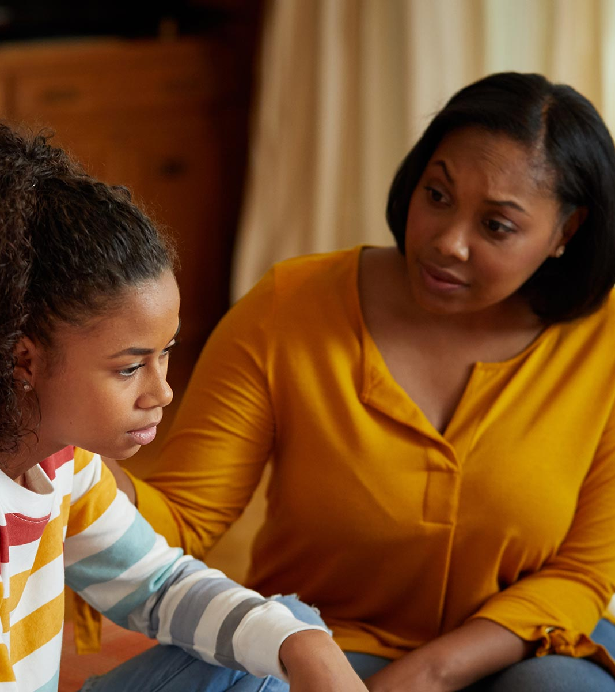
Knowing your child
For some parents/carers, your child is able to and perhaps already does access the internet alone.
For some parents/carers, your child would only access the internet with your help and support.
The internet is a wonderful tool for everyone but particularly people with disabilities and can enable them to be more independent and empowered. The solution is not to avoid/ban it altogether!
For children with additional needs, it can be helpful to set some simple black and white rules such as…

Slide 6
Rules/Guidance Ideas
Don’t upload any pictures of yourself or the family without us agreeing first
We keep the login details (and/or are in control of the social media account)
You can only use a social media platform if we are also using it, and we are ‘friends’
We need to know who each of your contacts are
Privacy settings must always be set to private
Location settings must always be off
Use of devices is in a communal area of the home, with us around and no use of headphones
We can check your search history
There is a time limit

Slide 7
The Main Online Risks for our students.
Grooming
Sharing Information and Images
Bullying
Gaming

Slide 8
Let’s watch this.
While you’re watching, try to keep an eye out for what places them both at risk.

Slide 9
What did you spot?
Both of them are vulnerable here
Both have technically broken the law
Who is keeping an eye on them?
She could have been talking to someone far more dangerous
He is vulnerable because he’s low in confidence
Because of her additional needs, she is very trusting
When young people can’t discuss sex, puberty and romantic feelings with someone they trust, they might try to explore this online.

Slide 10
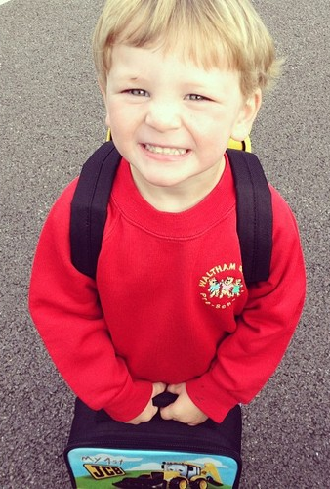
But first, Sharenting...
Be aware of what you share when Internet Dating, uploading holiday snaps etc
Asking permission before you share something about your child.
Keeping in mind their Digital Tattoo (could something you’ve shared affect their future?)
Remember that when you upload a picture of your child to Facebook or Instagram, they own the rights to that image and can use it where they want and/or sell it – without your permission.
Sometimes images of people with disabilities have been turned into cruel memes and gone viral.
When we share images of our child on their first day of school – we are giving away their location, from Monday–Friday between 9-3...does everyone need to know that?

Slide 12
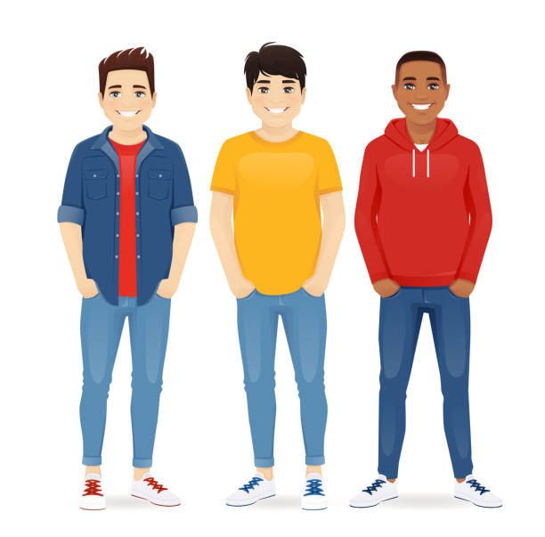
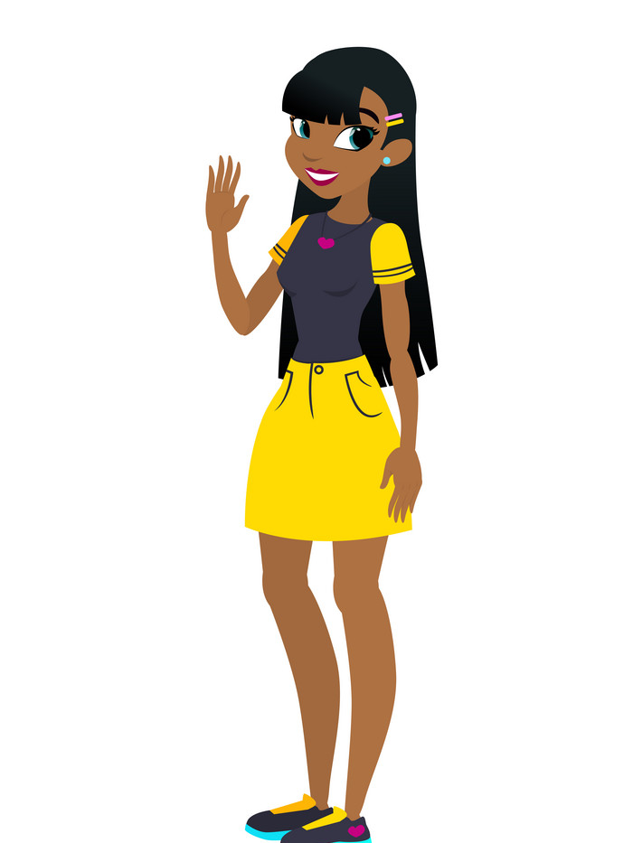
Online grooming

Slide 13
The Internet – a gift to Bad Guys (and girls)
One picture or secret is all it takes
Takes seconds to add 100s of young people
Lack of sleep and/or online gaming can lower inhibitions
Don't even need to add them if their profiles are not private
Can't see me – I can be whoever I want
Can see their friends list, so can add all their mates for good measure
Pictures – with a bit of flattery, can persuade them to go further
Don't need to ask their name and age, it's all there
Can pretend to like their hobbies
Don't need to slowly find out their vulnerabilities – it's all there
Can see their location (pictures, videos location settings on)

Slide 14
Why do people groom online?
For indecent images of children – for sexual gratification or to be sold (or both)
For access to that child's friends
To try to meet up with the child
For 'Sextortion' - to gain money from the child
To force the child into criminal exploitation
To humiliate and control the child

Slide 15
Privacy Settings
Support your child to keep themselves safe by setting their privacy settings to 'private’ or by being in charge of their social media account.
Don’t leave yours open when they’re around and might have access to your device.
BUT ensure that even if their accounts are private, the 'friends' or 'followers' they have on certain sites may not be real friends. Talk about what makes a good friend.
And remember – hashtags bring your child's posts and photos to an even wider audience e.g. #hotsummerdays #icecreamcrazy #cutedogsuk
Settings on most social media will usually look like 3 lines, 3 dots or a cog symbol like this:

Slide 16
Block, Report, Delete or Mute
Some social media (such as Discord) do not allow you to easily report someone – which is a big concern
However, it's important that you and your child know how to do this – and feel empowered to do so
You can look at terms and conditions on each platform for how to block, report, delete or mute
Report on CEOP – click the button and input the information if you feel your child has been groomed, or someone is trying to exploit them
Childline Report Remove Tool if images have been shared

Slide 17
Online Bullying

Slide 18
Online Bullying – things to remember
Bullying might come from someone your child knows in real life or may be from an anonymous stranger
Cruel messages sent to your child that are related to their disability, ethnicity, sexuality etc might be a hate crime and can be reported to the police
Tell us at school (even if you know your child has done something wrong too)
Delete, block, mute and report as soon as you can. Take screenshots if necessary

Slide 19
Gaming Online
Are you even aware they're online?
Easy to play with strangers
Can rack up large bills
18 certificates and adult themes
Can be addictive
Excessive gaming - links to health issues
Guard is down when they're excited and distracted (adrenaline)
May then start chatting using Discord etc

Slide 20
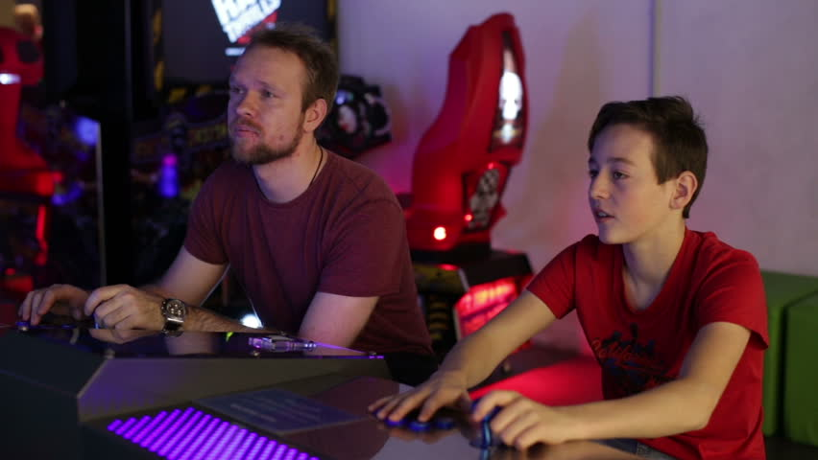
What can you do?
Play with your child or play the game yourself first
Encourage regular breaks
Have the games console or computer in a communal area in the home
Discourage the use of headphones (warning – may get noisy!)
Set time limits (Settings - Screen Time – App Limits on an Iphone)
Turn off internet at night
Set limits on only playing with family or friends you know IRL e.g. school mates
Choose age-appropriate games (think about your child’s developmental and emotional age):
https://parentzone.org.uk/article/choosing-right-console-games-christmas

Slide 21
Sharing Information and Images
Nude/semi-nude images or videos of anyone under the age of 18 are illegal.
Young people with disabilities can be more trusting and vulnerable to manipulation.
They might not realise what they are giving away about themselves and could be vulnerable to identity theft
They may be advertising to the world where they are at any given time
Make sure you monitor if they are spending any money online (using your bank cards) as they might not be legitimate sites
Think about whether you had to input bank details when they use an online game – they could be racking up debt without realizing.

Slide 22
Remember:
Snapchat and Whatsapp
Screenshotting
Snapchat and Whatsapp

Slide 23
Quick things you can do:
Look up apps and games on www.Netaware.com for information and safety advice
Download the National Online Safety app – it's free!
Youtube explainer videos can be a helpful thing to watch with your child. Try CEOP, National Online Safety, Childline, NSPCC and Internet Matters
Download Youtube Kids rather than Youtube as it filters out most inappropriate content for younger children

Slide 24
Quick things you can do:
Security settings stop your child from being able to access sites about violence, pornography, pro-anorexia sites etc
Go into o2 shops with any of your devices and they will show you how, for free! Or call the o2/NSPCC free helpline 0808 800 5002
Use Parental Controls to Keep Your Child Safe | NSPCC
www.thinkuknow.co.uk has advice for parents, videos to watch together and explanations of new trends
Sign up to NSPCC Ice Breaker emails (https://nspcc.o2.co.uk/)

Slide 25
Here's an example of a Family Agreement that can be helpful for younger teenagers and children. It can be found on the Childnet website

Slide 26
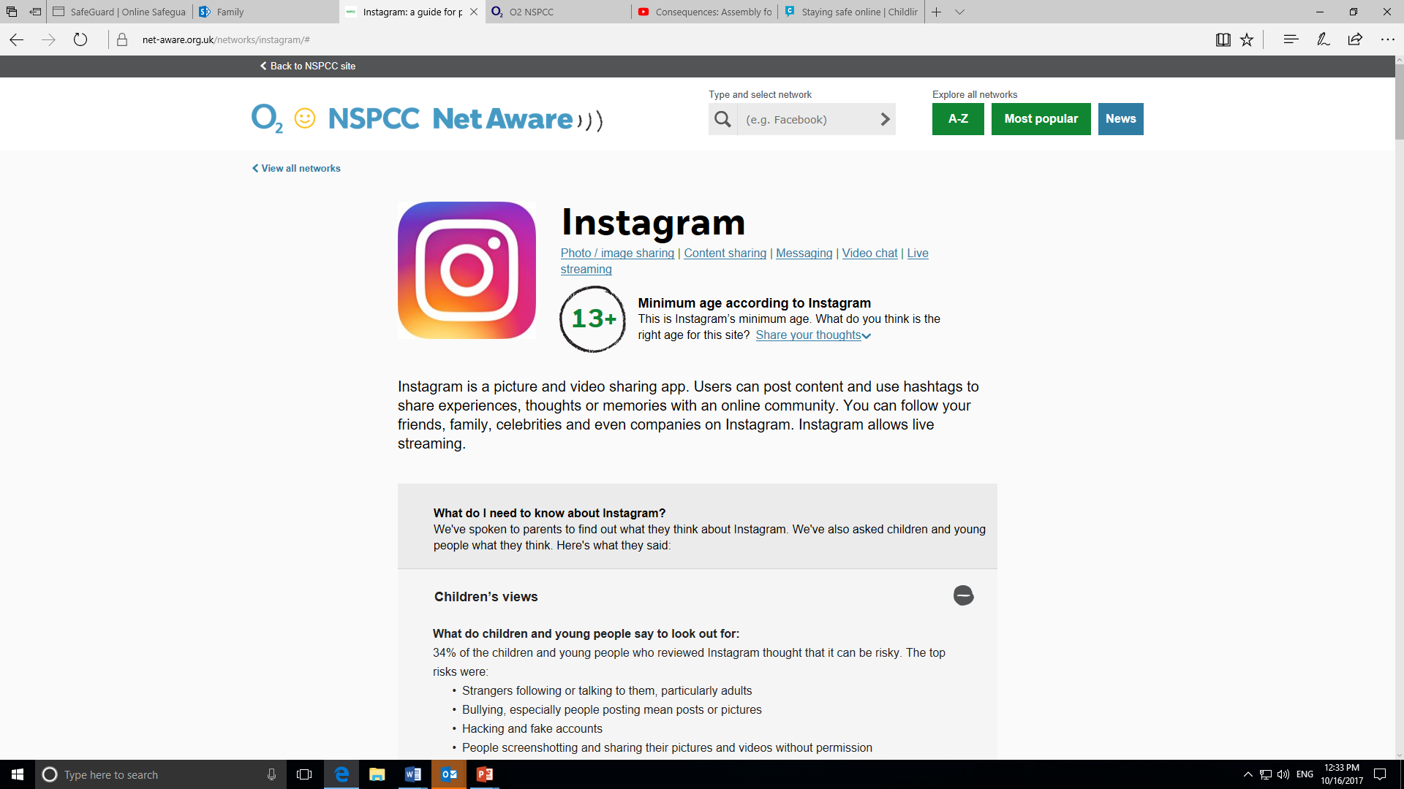
The Netaware website looks like this. You can type in the name of the app or game and it gives you a breakdown of what it is, how it works, safety features and things to be mindful of.

Slide 27
The National Online Safety app has handy one-pager breakdowns of many apps and games. As it's on your phone, you can simply type something in that your child has mentioned and instantly have an understanding of how it works...and how to keep them safer whilst using it!

Slide 28
Any questions?

